Slide 1

AGENTIC AI ----------------------- HUGGINGFACE‘S SMOLAGENTS
K. Prakash Senapati

Slide 2

1. Resume Building Bootcamp for Data Analytics, BA, Data Science & GEN AI Roles ➔ playlist?list=PLVlQHNRLflP-SaPff3325gkISMHEznEix 2. Agenitic AI ➔ playlist?list=PLVlQHNRLflP8Pt3wVlRWRaXZXi79cIwSq 3. Data Analytics & Business Analytics ➔ playlist?list=PLVlQHNRLflP-BgYmMlM8YQpvQM2J99HE0 4. Generative AI ➔ playlist?list=PLVlQHNRLflP81c99eg7UhkVZxwPvhTddM 5. Python for Datascience ➔ playlist?list=PLVlQHNRLflP9GN5rc8sBWnrV53DWAzfdn 6. AZUR AI (Cognitive Services for Data Scientist) ➔ playlist?list=PLVlQHNRLflP8JthpjvJFaofUkJS1A7qa1
YOUTUBE PLAYLIST ➔

Slide 3
WHAT IS AGENTIC AI ➔
What is Agentic AI in Simple Terms?
Agentic AI refers to AI systems that can take independent actions, make decisions, and complete tasks without constant human input. Unlike traditional AI, which only responds when asked, Agentic AI plans, reasons, and executes tasks on its own.
Example →
AutoGPT & BabyAGI → AI agents that set goals and complete tasks automatically.
Self-Driving Cars → Analyze the road, make driving decisions, and adjust routes.
AI Personal Assistants → Plan schedules, book flights, and send emails without manual input.
Stock Trading Bots → Make buying and selling decisions based on market trends.

Slide 4
How Does Agentic AI Work?
Understands Goals → AI knows what needs to be done.
Plans & Strategizes → Breaks tasks into steps and finds the best way to complete them.
Takes Actions → Executes tasks independently (e.g., searching the web, sending emails, making decisions).
Learns & Adapts → Improves over time based on past actions.
Why is Agentic AI Special?
✅ Autonomous Decision-Making – Works without needing constant instructions. ✅ Multi-Step Task Handling – Can complete complex workflows. ✅ Self-Learning – Improves and adapts based on experience.
Agentic AI is like an AI assistant that doesn’t just follow orders—it thinks, plans, and acts on its own to get things done!

Slide 5
Agentic AI Frameworks
LangChain & LangGraph
Phi data
Crew AI
AutoGen
Smolagents
Manus AI
Grok3
n8n
Auto GPT
Baby AGI
AutoGen

Slide 6
SmolAgents: A Lightweight Agentic AI Framework ➔
SmolAgents is a lightweight, simple, and efficient AI agent framework designed to help AI models autonomously plan and execute tasks with minimal complexity.
Unlike heavy agentic frameworks like AutoGPT and BabyAGI, SmolAgents focuses on: ✅ Simplicity – Easy to use and lightweight. ✅ Efficiency – Doesn’t require heavy computing power. ✅ Task Automation – Handles reasoning, planning, and execution.
How SmolAgents Work?
SmolAgents function by:
Receiving a goal/task – The user provides an objective.
Breaking it down into steps – The AI plans sub-tasks.
Executing the plan autonomously – It takes action with minimal user intervention.
Refining outputs – AI learns from mistakes and adjusts.

Slide 7
🔹 Use Cases for SmolAgents ➔
✅ Personal AI Assistants – Automate daily tasks like scheduling. ✅ Research & Web Scraping – AI autonomously gathers information. ✅ Content Generation – AI generates blog posts, scripts, or reports. ✅ Coding Assistance – AI writes, debugs, and improves code.
Why Use SmolAgents?➔
🔹 Minimal Setup – Works without complex installations. 🔹 Fast & Lightweight – Doesn’t require large computing resources. 🔹 Easy to Integrate – Can work with GPT-4, LangChain, OpenAI, Hugging Face, and other APIs.
Official Website: smolagents.org
Hugging Face Blog Announcement: huggingface.co
GitHub Repository: github.com
Documentation: huggingface.co

Slide 8

AGETIC AI PROJECT➔
IDE → VS code
Agentic AI Framework → Smolagents
Search Engine → Duck-Duck Go Search
LLM Model → Google Gemini Genrative AI
Frontend → Gradio UI
====
Project:1 →Test the Smol Agents
Project:2 → Build Code Generative Agents

Slide 9
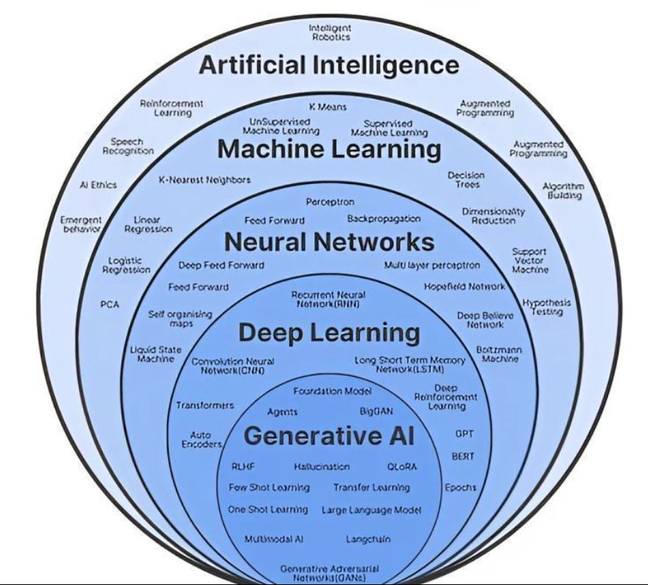

Slide 10



